Slide 1
Welcome
Jubilee School PTA
Charity AGM
Thursday 13 February 2025
Jubilee School PTA is a registered charity, number 1179031

Slide 2
It’s your PTA
Your skills and ideas make a difference
Nothing happens without you
Thank you for being part of it
Our charity is member-led
You make our school better
Charity number 1179031

Slide 3
AGM process
Annual Report
Co-chairs’ report on 2023-24 activity
Accounts
Treasurer’s report on 2023-24's
income & spending.
Vote to approve Annual Report & Accounts
New plans
Charity structure proposal
Trustees
Current Trustees resign
Nominations sought
Vote to elect new Trustees
Charity number 1179031

Slide 4
Annual Report
Jubilee School PTA is a registered charity, number 1179031

Slide 5
sponsorships, employer match funding
gardening sessions
You helped with ...
Yard Sale, Bonfire Night, Make Bake Create
hearing kids read, library and classroom shelves
International Welcome, Celebration of Black Culture, Eid Party
pop-up stalls, bakes and ice cream sales, preloved uniform
seeking grants and funding
3 kids discos, a movie night, choir’s Carol Concert
Regular Giving scheme, easyfundraising, GiftAid
Summer and Winter Fairs and a raffle
Sporting challenges, Readathon
Charity number 1179031

Slide 6
our children spent time with authors in their classrooms
Which meant ...
every child received a gift at Christmas
180 kids had a drama, speech, performance session
430 kids spent time growing and tasting food with a gardener
hundreds of wearable garments were kept out of landfill
135 solar panels were installed and are generating power!
kids have keyboards to use in music lessons
Year 6 pupils each received a leaver’s t-shirt
we supported trips with bursaries and ‘pay it forward’ help
50 children spent time reading to a volunteer
Charity number 1179031

Slide 7
2023-24 Accounts
Jubilee School PTA is a registered charity, number 1179031

Slide 8
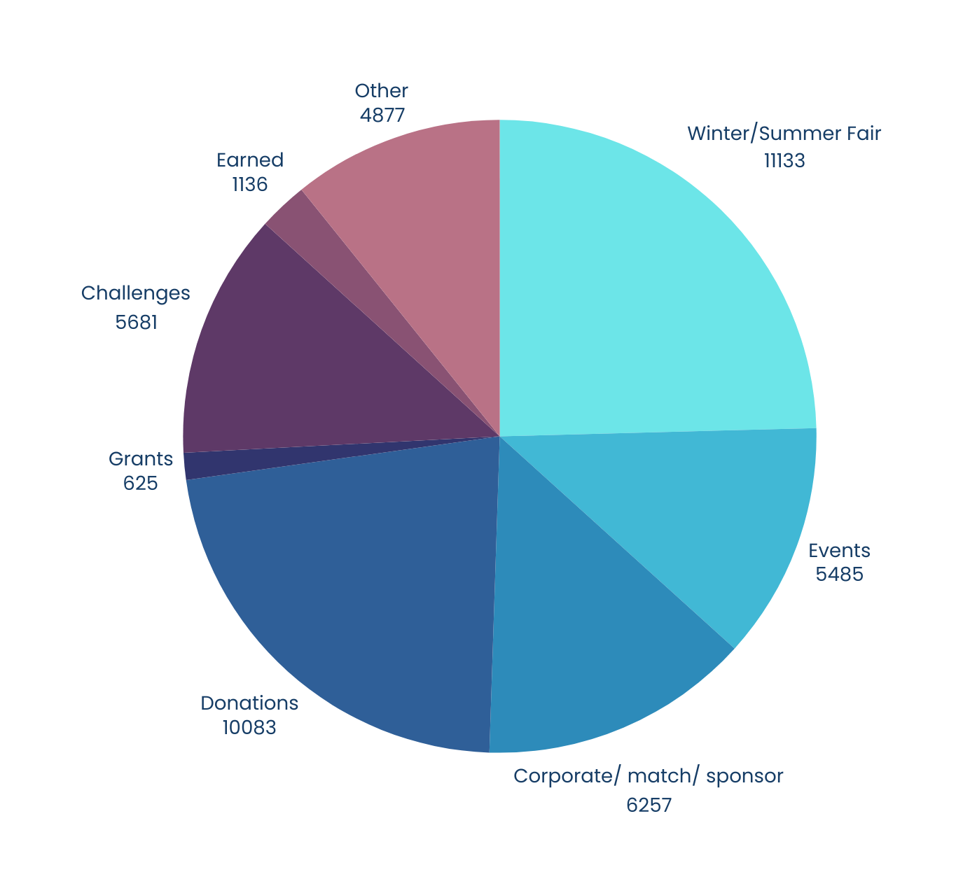
2023-24 fundraising total
£45,280
Does not include £44,493 grants paid directly to the school
Charity number 1179031

Slide 9
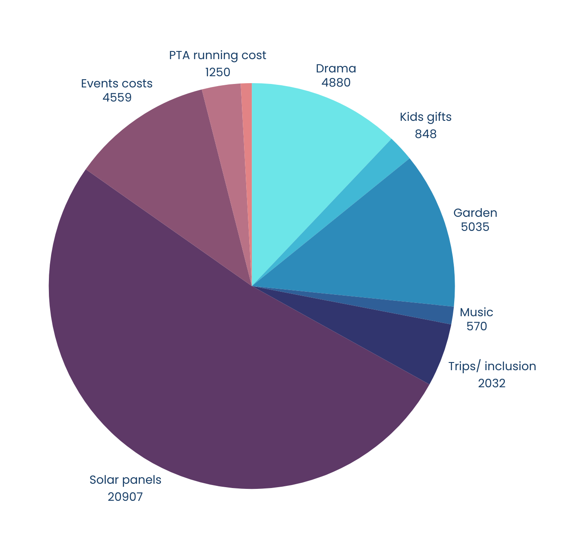
2023-24
spending total
£41,804
Reserves carried forward
£31,008
Charity number 1179031

Slide 10
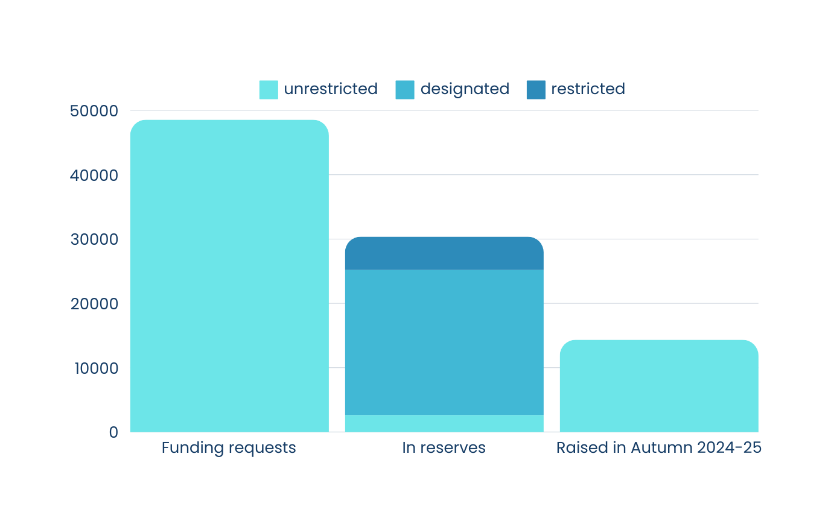
Current position
Charity number 1179031

Slide 11
trips, bursaries and inclusion
Forest School kit refresh
We’re supporting...
playground resources
new phonics books
drama, speech, and performance sessions
gifts and marking milestones (eg leavers tshirts)
KS1 book corners
shading sunny classrooms
more books for the library and classrooms
garden sessions for all children
events to raise money and make memories for kids
murals and environmental improvements
Charity number 1179031

Slide 12
New Plans
Jubilee School PTA is a registered charity, number 1179031

Slide 13
Events
Fundraising
Jubilee School Charity
Library
Preloved Uniform
Gardening
Reading

Slide 14
Trustees
Jubilee School PTA is a registered charity, number 1179031

Slide 15
Nominees
Ayesha Sayed
Cennydd John
Chris Pope
Matthew Gretton
Tania
Nile
Kids in Y2 and YR
Kids in Y2 & Y1
Kids in Y2,
Nursery & a tiny one
Kids in YR and Y2
Kid in Y2
I love helping out in the school and I like to get out of my comfort zone and give myself a challenge. So far, I’ve really enjoyed being a part of school events and volunteering on PTA projects, like the Library.
CEO of Hatching Dragons, leads bilingual early years education and developed the EYE Curriculum. He supports initiatives like Smartphone Free Childhood and coaches a children’s rugby team. He aims to grow Jubilee’s revenue with his expertise.
Previously Honorary Secretary for five years for my rugby club in north west London and 2 years as Treasurer with the PTA. I am very happy to help out to ensure the PTA can continue doing its great work in supporting the school.
Having been part of the school community for over a year, I have greatly appreciated the variety of activities organised by the PTA. I would love to contribute to these efforts and also advocate for the Assisted Reading programme within the PTA.
I'm hoping to bring and further develop my skills and insights from working in education and in charities, to the school community. I'm also looking forward to getting to know more families and teachers in the school!
Charity number 1179031

Slide 16
Thank you ...
Jubilee School PTA is a registered charity, number 1179031

Slide 17
Stay for a coffee?
Jubilee School PTA is a registered charity, number 1179031

